Slide 1

GLOBAL PLASTIC POLLUTION ANALYSIS
Under the Esteemed Guidance of
SHILPA HARIRAJ
PRESENTED BY-
HARISH KM(1VE20CS047)
C N DILIP KRISHNA(1VE20CS026)
ADARSH M(1VE20CS003)
APPU ANNAVERAPPA(1VE20CS019)
BHAGYALAXMI SHEELVANT(1VE20CS022)

Slide 2
INTRODUCTION
This summarizes a global analysis of plastic pollution. Assessing the pervasive issue, the study explores the environmental impact, socioeconomic consequences, and mitigation strategies. Utilizing comprehensive data sets, the research identifies key contributors to plastic pollution, highlighting geographical hotspots and the ecological ramifications. Additionally, it examines emerging technologies and policy interventions aimed at curbing plastic waste. The findings provide valuable insights for policymakers, environmentalists, and industries to collaboratively address this urgent global challenge, fostering sustainable practices and promoting a circular economy to mitigate the detrimental effects of plastic pollution on ecosystems and human well-being.

Slide 3
PROBLEM STATEMENT
The escalating issue of plastic pollution poses a severe threat to biodiversity, ecosystems, and socio-economic stability on a global scale. This persistent contamination transcends geographical boundaries, necessitating a comprehensive understanding of its sources, distribution, and impact. Urgent action is required to identify and implement effective strategies that address the root causes and mitigate the detrimental effects of plastic pollution on the environment and human well-being.

Slide 4
PROPOSED METHODOLOGY
Data Collection and Analysis
Establish a global database to collect and analyze data on plastic pollution sources, distribution, and environmental impact. Implement advanced data analytics to identify trends, hotspots, and key contributors.
Technology Integration
Integrate cutting-edge technologies for plastic waste collection, sorting, and recycling. Develop a technology roadmap for continuous innovation and adoption.

Slide 5
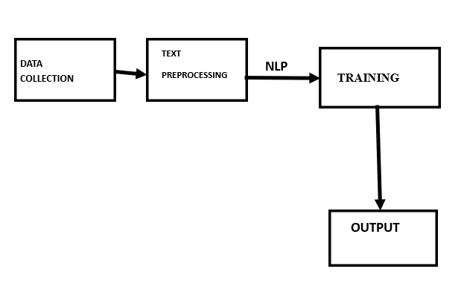
MODULES USED
Fig.1.Data Flow Diagram

Slide 6
ADVANTAGES
Enables thorough data analysis for informed decision-making.
Facilitates effective collaboration among diverse stakeholders globally.
Establishes and enforces consistent international regulatory standards.
Integrates cutting-edge technologies for efficient plastic waste management.
Utilizes a global awareness platform to encourage responsible consumer behavior.
Tests and refines strategies through evidence-based pilot programs.

Slide 7
HARDWARE REQUIREMENTS
CPU: Utilized for data processing and model training.
RAM: Required for handling and manipulating large datasets during analysis and modeling.
Storage: Used to store the datasets and code files required for analysis.
GPU (if available): Sometimes employed to expedite computations in machine learning processes, especially for large datasets and complex models.

Slide 8
SOFTWARE REQUIREMENTS
Python: Utilized for coding and implementing machine learning models.
Scikit-learn: Employed for implementing classification algorithms like Logistic Regression, Naive Bayes, Decision Tree, Random Forest, AdaBoost, SVM, Linear Discriminant Analysis, MLP, and K-Nearest Neighbors.
Pandas and NumPy: Used for data manipulation and analysis.
Principal Component Analysis (PCA): Applied for feature reduction and optimization.
Jupyter Notebooks: Utilized as an interactive environment for analysis and code execution.
Matplotlib and Seaborn: Used for data visualization and result interpretation.

Slide 9
IMPLENTATION & RESULTS
Significant mitigation of the adverse effects of plastic pollution.
Creation of a sustainable and resilient future for ecosystems.
Enhancement of human societies' resilience against plastic pollution impacts.
Development of comprehensive strategies addressing the root causes of plastic pollution.

Slide 10
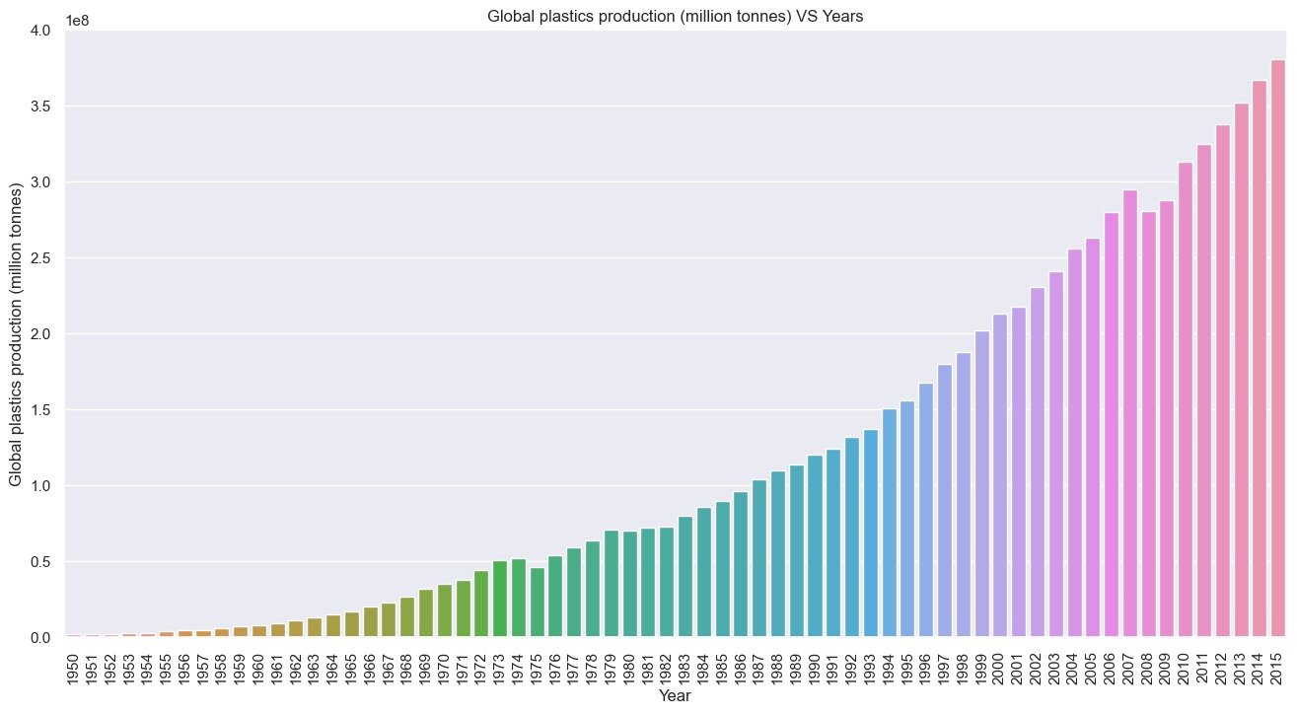
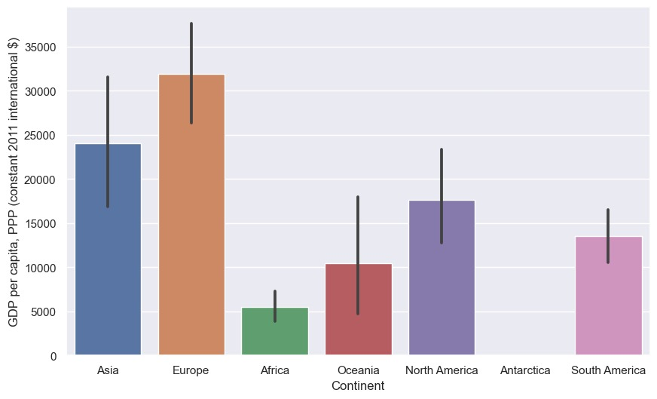

Slide 11
CONCLUSION
In conclusion, the proposed system for global plastic pollution mitigation presents a comprehensive and forward-thinking approach to address the urgent environmental challenge posed by plastic pollution. By leveraging data-driven insights, international collaboration, and innovative technologies, the system aims to tackle the root causes of plastic pollution at a global scale. The inclusion of pilot programs, real-time monitoring, and adaptive management ensures the continuous refinement of strategies for maximum effectiveness. The emphasis on public awareness, stakeholder engagement, and a secure global collaboration platform reflects a commitment to inclusivity and transparency. As this system is implemented, it holds the potential to significantly reduce the impact of plastic pollution on ecosystems, biodiversity, and human well-being, fostering a more sustainable and resilient future for the planet.

Slide 12
REFERENCES
Datasets : Kaggle
https://www.kaggle.com/datasets/sohamgade/plastic-datasets
Git hub link
https://github.com/adarsh852

Slide 13


